Slide 1

Nuveen Sales Targets
Liam Smith

Slide 2
Agenda
Background
Objectives
Methodology
Variables
Findings
Recommendations
Notes:
Jon

Slide 3
Background
Nuveen creates and sells investment products
AUM $1.2 Trillion
Sales department targets clients to market their products
Financial advisors
High-net-worth individuals
Wealth Management firms
Insurance companies
Charge investors a percent of assets under management
Notes:
Jon

Slide 4
Objectives
Create Logistic and Least Squares Regression models for comparison.
Use the best model to advise the Nuveen sales force by telling them which clients to target and which asset classes the targets are most likely to buy based on predicted totals.
This will allow Nuveen to have a greater rate of success with the Wells Fargo advisors that they contact
Notes:
Luke
Determine who sales force should target/what they should present/pitch to these advisors

Slide 5
Methodology
Explore data
Merge Wells Fargo (Financials) & Discovery (Demographics) datasets
Data manipulation/cleaning
Split data into training and testing sets
Determine which type of model to use (LSR vs Logistic)
Develop models for each asset class
Create lift charts
Communicate recommendations to the sales team based on the models
Notes:
Luke

Slide 6

Logistic Regression
Predicts how likely WF advisors are to purchase $1000 or more in Nuveen assets in the next 3 months.
Notes:
Jon

Slide 7
Logistic Regression – Variables
Purchased 2+ asset classes
Advisor age 45+
Total Nuveen 9-month sales
Total Nuveen 21-month sales
Mutual Fund AUM investment grade bonds
Nuveen 21-month net sales of high yield taxable bonds (-)
Notes:
Jon

Slide 8
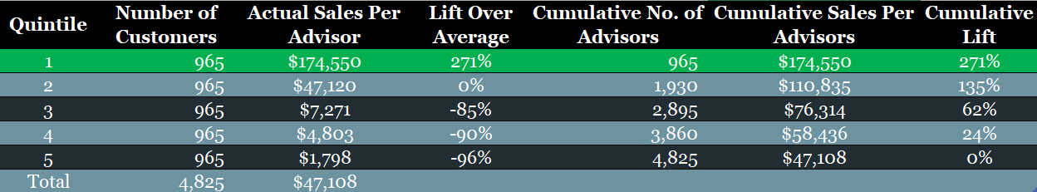
Logistic Regression – Findings
70% of advisors in Quintile 1 had sales of over $1,000
Notes:
Liam

Slide 9
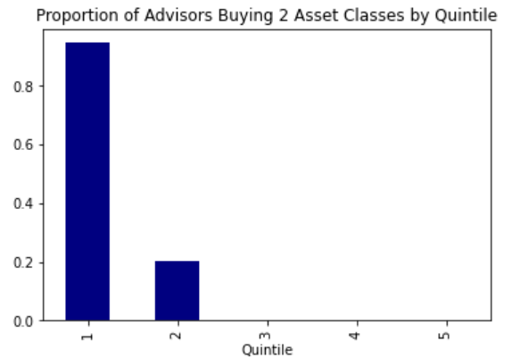
Most significant variable to Logistic model Indicates that +90% of advisors in Quintile 1 purchase products in 2 or more asset classes
Logistic Model
Notes:
Jon

Slide 10
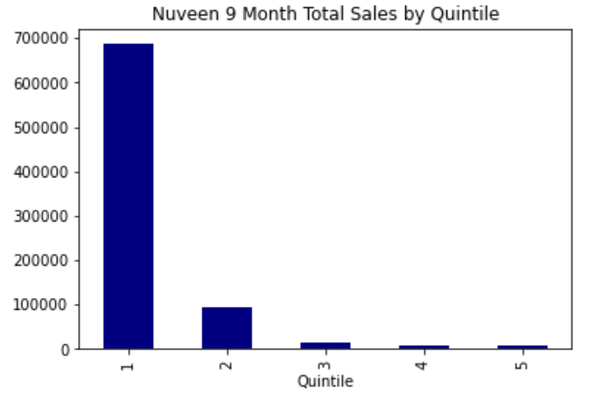
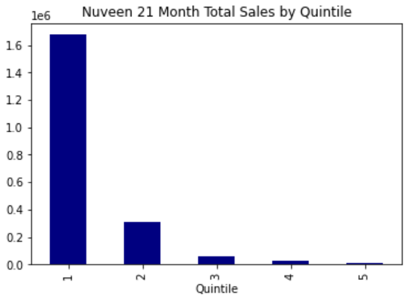
Predicted strongest targets in Logistic Model have highest total sales in both trailing 9 months and 21 months
Logistic Model
Notes:
Jon

Slide 11
Least Squares Regression
Predicts how much each WF advisor will purchase in Nuveen assets in the next 3 months.
Notes:
Jon

Slide 12
LSR – Variables
Total 9-month sales investment grade
Total 9-month sales municipal bonds
Nuveen 9-month sales high yield taxable
Nuveen 9-month sales total
Total 21-month sales international bonds
Total 21-month sales investment grade
Total 21-month sales municipal bonds (-)
Nuveen 21-month sales high yield taxable
Nuveen 9-month redemptions alternatives
Total 21-month redemptions international bonds
Nuveen 21-month redemptions investment grade
Nuveen 21-month redemptions international bonds
Mutual fund AUM international bonds (-)
Mutual fund AUM alternatives
Mutual fund AUM total
Total 9-month net sales high yield taxable (-)
Nuveen 9-month net sales high yield taxable
Total 21-month net sales alternatives
Total 21-month net sales US equity
Notes:
Jon

Slide 13
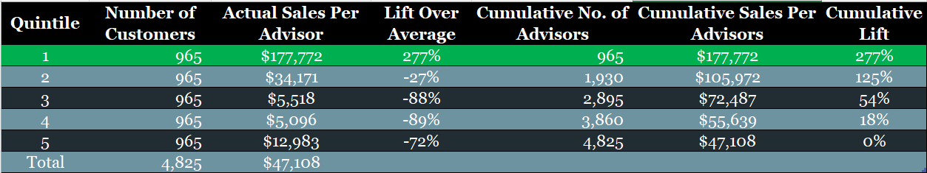
LSR – Findings
Quintile 1 is only group contributing lift to the model
Quintiles 2-5 sales per advisor is below average
Notes:
Liam

Slide 14
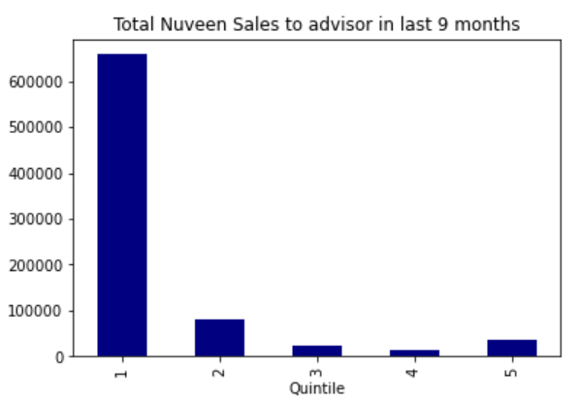
Most significant variable to LSR model Demonstrates the large discrepancy in last 9 months sales in Quintile 1 vs others
LSR Model
Notes:
Ryan

Slide 15
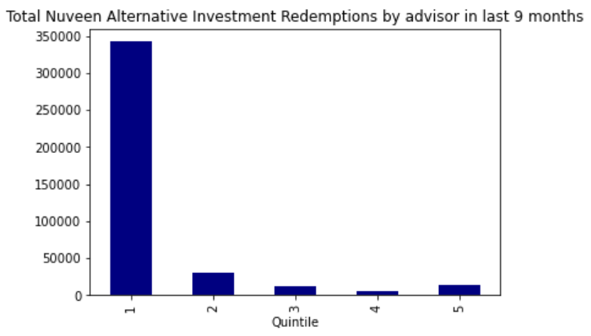
Predicted strongest targets in LSR have most redemptions of Alternative Investments in the last 9 months
LSR Model
Notes:
Ryan

Slide 16
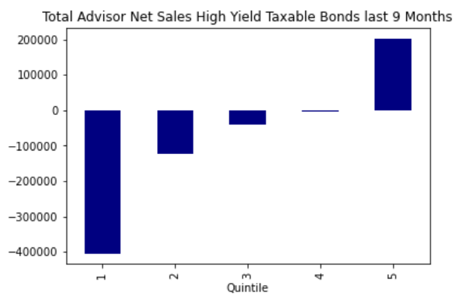
Net Sales of High Yield Taxable Bonds increases as Quintiles go down
LSR Model
Notes:
Ryan

Slide 17
Model Comparison – Quintile Totals
Least Squares Regression
Logistic Regression
$177,772
$34,171
$5518
$5096
$12,983
$174,550
$47,120
$7271
$4803
$1798
Notes:
Liam

Slide 18
Lift Chart Comparison
Use the Logistic Regression Model
Notes:
Ryan

Slide 19
Municipal Bonds
Predicts which advisors are most likely to buy Municipal Bonds in the next 3 months.
Notes:
Liam

Slide 20
Municipal Bonds – Variables
Total 9-month sales of US equity
Nuveen 9-month sales municipal bonds
Nuveen 21-month sales high yield taxable
Total 9-month redemptions international equity
Total 9-month redemptions municipal bonds (-)
Mutual Fund AUM investment grade bonds
Mutual Fund AUM municipal bonds
Total 21-month net sales US equity
Purchased assets in 2+ classes
Purchased assets in 3+ classes
Advisor age 45+
Notes:
Liam

Slide 21
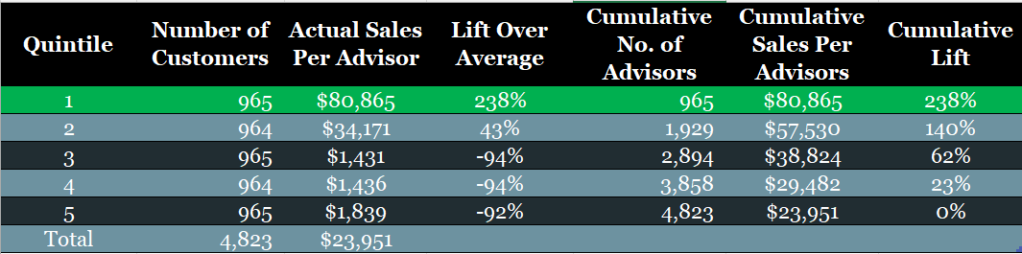
Municipal Bonds – Findings
Quintile 1 identified as strongest, about 50% of advisors purchasing over $1,000
Quintile 2 is strong with sales per advisor clearing the average
Notes:
Liam

Slide 22
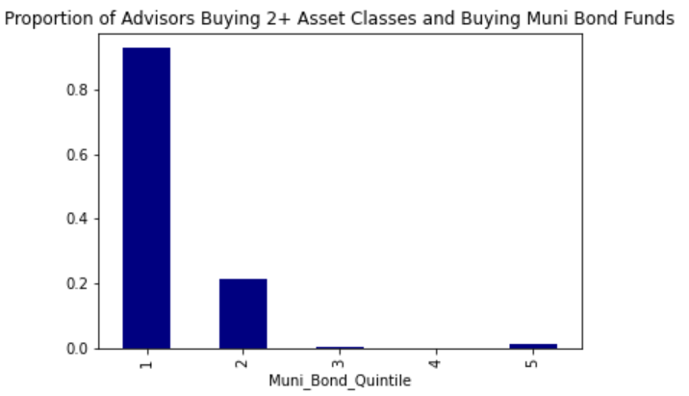
Predicted top targets have higher percentage of advisors purchasing 2+ asset classes
Municipal Bond Model
Notes:
Luke

Slide 23
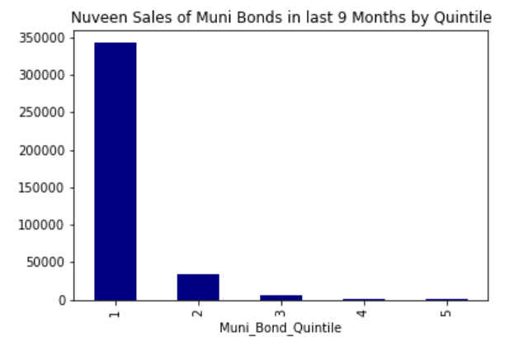
Top quintile has most sales of municipal bonds
Municipal Bond Model
Notes:
Luke

Slide 24
US Equity
Predicts which advisors are most likely to buy US Equity in the next 3 months.
Notes:
Ryan

Slide 25
US Equity - Variables
Nuveen 9-month sales US Equity
Nuveen 9-month redemptions US Equity
Nuveen 21-month net sales International Equity
Purchased Assets in 2+ Classes
Notes:
Ryan

Slide 26
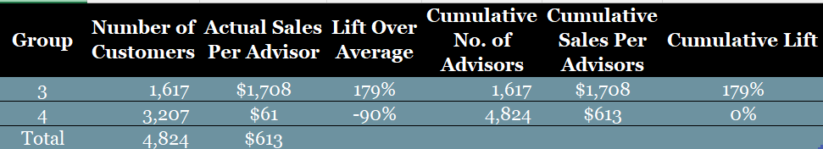
US Equity – Findings
No “strong” groups identified
Downgraded groups to 3 and 4 level
Group 3 significantly better than Group 4, but less than 5% of advisors purchasing over $1000
Notes:
Ryan

Slide 27
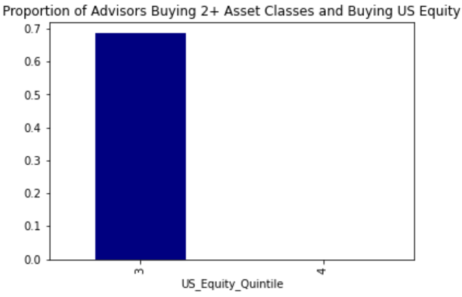
Top group has a high proportion of advisors buying 2+ asset classes
US Equity Model
Notes:
Luke

Slide 28
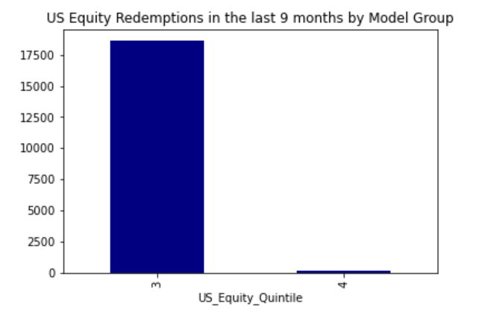
Top group has most US Equity redemptions past 9-months
US Equity Model
Notes:
Luke

Slide 29
Investment Grade Bonds
Predicts which advisors are most likely to buy Investment Grade Bonds in the next 3 months.
Notes:
Ryan

Slide 30
Investment Grade Bonds – Variables
Nuveen 9-month sales High Yield Taxable (-)
Nuveen 21-month sales Investment Grade Taxable
Nuveen 9-month net sales Investment Grade Taxable
Purchased Assets in 2+ Classes
Notes:
Ryan

Slide 31
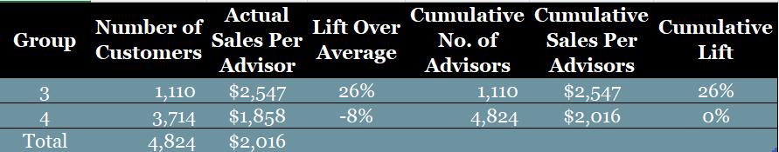
Investment Grade Bonds – Findings
No “strong” groups identified
Downgraded groups to 3 and 4 level
Less than 3% of advisors in Group 3 purchased more than $1000 of IG Bonds
Notes:
$1000
10x better but still bad
Sales less than double
Probably on outlier in group 2 bringing up average

Slide 32
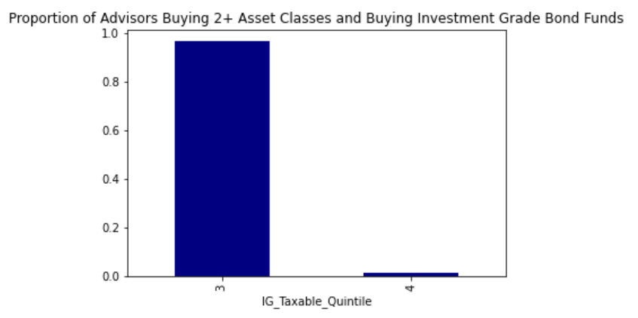
Top group has almost 100% of advisors purchasing 2+ asset classes
Investment Grade Bond Model
Notes:
Ryan

Slide 33
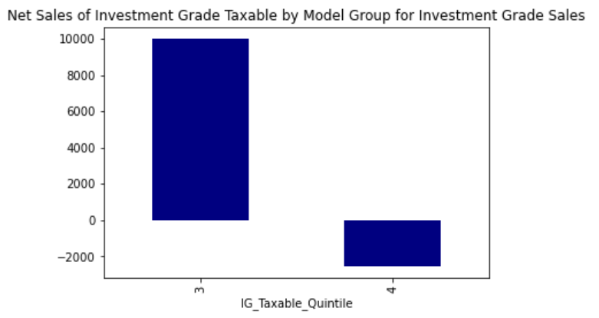
Top group advisors are net buyers of Investment Grade bonds
Investment Grade Bond Model
Notes:
Ryan

Slide 34
High Yield Bonds
Predicts which advisors are most likely to buy High Yield bonds in the next 3 months.
Notes:
Ryan

Slide 35
High Yield Bonds – Variables
Nuveen 21-month sales of High Yield Taxable Bonds
Total Redemptions last 9 months
Investment Grade Taxable Redemptions last 21 months
Purchased Assets in 3+ Classes
Notes:
Ryan

Slide 36
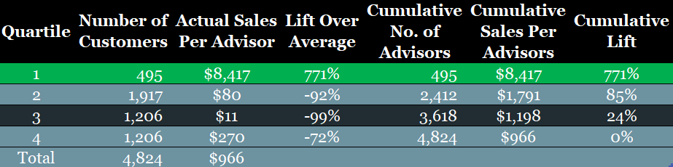
High Yield Bonds – Findings
Just under 10% of advisors in Quartile 1 purchased over $1000 of High Yield Bonds
No other Quartile had more .1% of advisors purchasing this amount
Notes:
Ryan

Slide 37
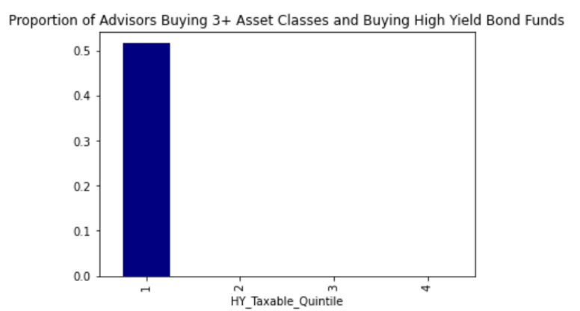
Top quartile had all advisors that purchased 3+ asset classes
High Yield Bond Model

Slide 38
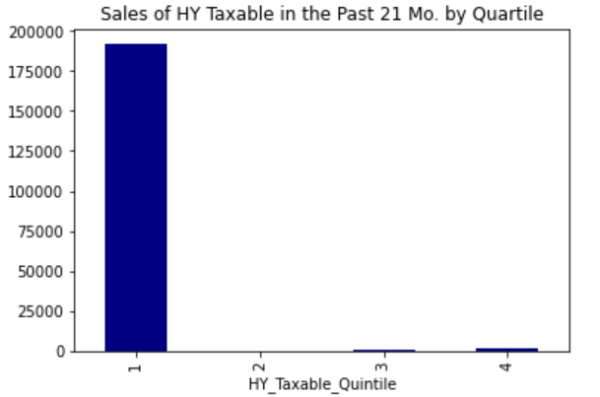
Predicted top targets had most sales of High Yield Bonds
High Yield Bond Model

Slide 39
Alternative Investments
Predicts which advisors are most likely to buy Alternative Investments in the next 3 months.
Notes:
Ryan

Slide 40
Alternative Investments – Variables
Nuveen 9-month sales of Alternative Investments
21 Month Alternative Investment Redemptions
Purchased Assets in 2+ Classes

Slide 41
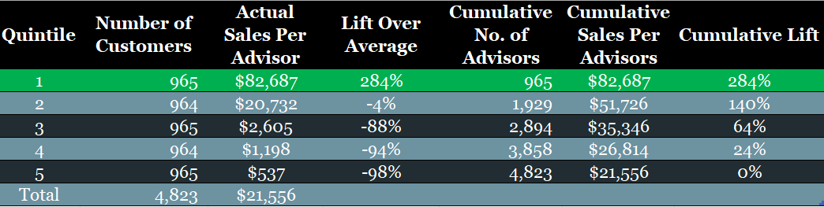
Alternative Investments – Findings
47% of advisors in Quintile 1 purchased over $1,000 of Alternative Investments
Notes:
Ryan

Slide 42
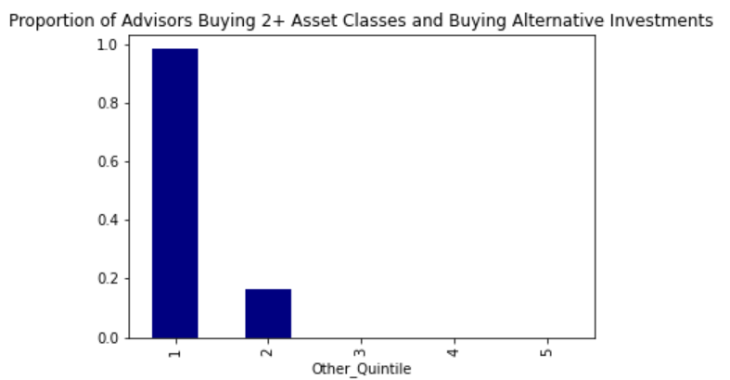
Top quintile had almost 100% of advisors purchasing 2+ asset classes
Alternative Investments Model

Slide 43
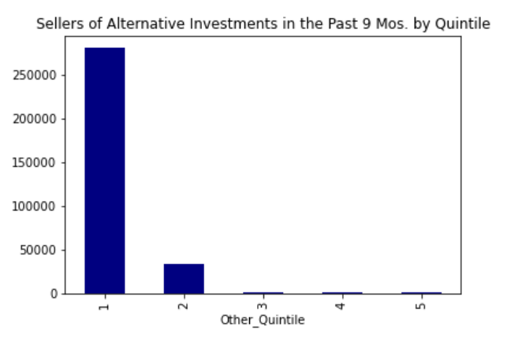
Predicted top targets bought most alternative investments
Alternative Investments Model

Slide 44
Recommendations

Slide 45
Recommendations
Use the Logistic Regression model to determine who to visit
Pressure the purchase of multiple asset classes
Use asset class models to determine which products to pitch to advisors
Focus vast majority of resources on targeting advisors in top quintiles
Visit advisors
Make phone calls
Host events
Use cheapest resources on targeting advisors in lowest quintiles
Email marketing
Notes:
Luke

Slide 46

Thank You! Questions?

